Slide 1
AutoQ 2.0: From Verification of Quantum Circuits
to Verification of Quantum Programs
Yu-Fang Chen¹, Kai-Min Chung¹, Min-Hsiu Hsieh², Wei-Jia Huang², Ondřej Lengál³, Jyun-Ao Lin⁴, Wei-Lun Tsai¹
¹ Institute of Information Science, Academia Sinica, Taipei, Taiwan, ² Hon Hai Quantum Computing Research Center, Taipei, Taiwan, ³ Faculty of Information Technology, Brno University of Technology, Brno, Czech Republic,
⁴ Innovation Frontier Institute of Research for Science and Technology & Department of
Computer Science and Information Engineering,
National Taipei University of Technology, Taipei, Taiwan
Notes:
Hello everyone, thanks for the introduction, and I am Wei-Lun Tsai from Academia Sinica. Today, I am going to introduce our quantum verification tool AutoQ, and our main contribution in this work is to generalize the verification from Quantum Circuits to Quantum Programs.
複誦標題、作者，再次強調 AutoQ 是量子電路驗證 framework、並且這篇論文的貢獻是從量子電路推廣到量子程式

Slide 2
Outline
Basics of Quantum Computing
AutoQ 1.0: A Quantum (Circuit) Verification Framework
AutoQ 2.0: From Quantum Circuits to Quantum Programs
Possible Improvement and Summary
Notes:
This is the outline. The first part is the basics of quantum computing, which is the necessary background for understanding quantum verification.
In the second part, I will introduce our tool AutoQ and explain how to use it for quantum circuits.
With the knowledge of the first version, we will then go through how to generalize the framework from quantum circuits to quantum programs, which is our main contribution.
And at the end, I will mention one possible improvement and conclude our work.
為了要解釋量子程式驗證，勢必要先解釋量子計算的基本常識。
再解釋我們的前作量子驗證框架 AutoQ
接著是本篇論文的主要貢獻
最後才是目前的隱憂與可改進方向、以及結論

Slide 3
Basics of Quantum Computing

Slide 4
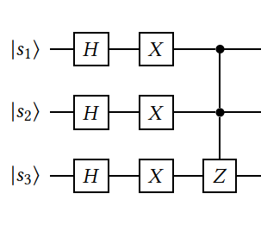
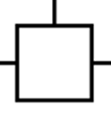
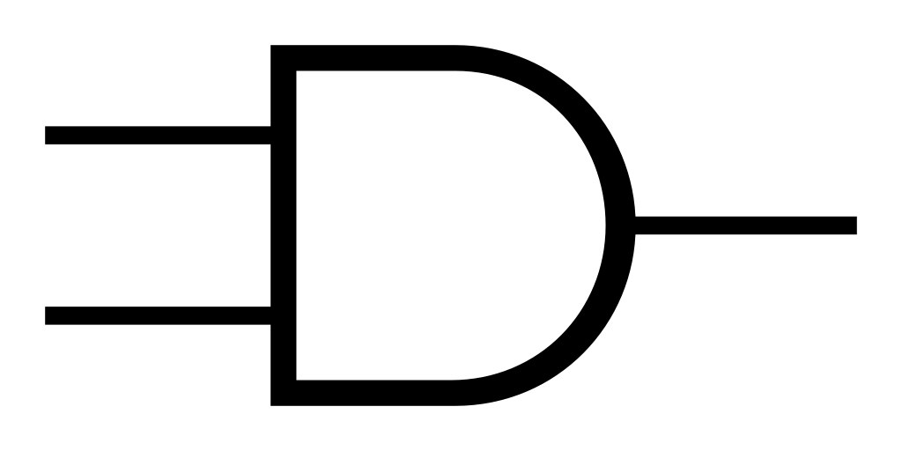


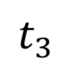
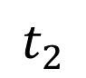
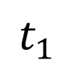
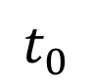
A Classical Circuit
0
0
1
1
b₁
1
0
1
1
b₂
0
1
1
1
b₃
$$t_{0}$$
$$t_{1}$$
$$t_{2}$$
$$t_{3}$$
Notes:
This is a 3-bit classical logic circuit, which is the predecessor of quantum circuits.
It contains a sequence of logic gates. A logic gate takes a number of bits as the input and outputs the result to another bit.
As you can see, at each time slot, each bit can only take the value of zero or one, and the values may be changed after passing through logic gates. If we see the three bits together, they can only possess one binary string at a time. For example, the binary string at $t_{1}$ is 001, and at $t_{2}$ is 111.
為了要解釋量子電路，必須先從傳統電路開始。強調每個時間點，都只會有一個 binary string.

Slide 5
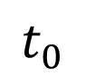
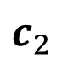
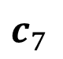
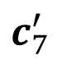
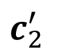
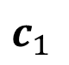
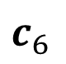
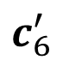
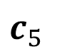
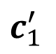
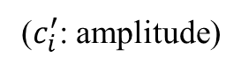
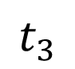
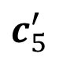
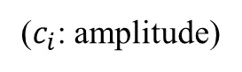
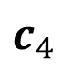
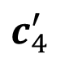
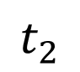
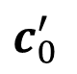
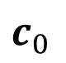
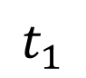
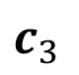
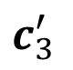
Generalized to a Quantum Circuit
($c_{i}$: amplitude)
($c_{i}^{′}$: amplitude)
0
0
0
$$c_{0}$$
0
0
0
$$c_{0}^{′}$$
0
0
1
$$c_{1}$$
0
0
1
$$c_{1}^{′}$$
0
1
0
$$c_{2}$$
0
1
0
$$c_{2}^{′}$$
0
1
1
$$c_{3}$$
0
1
1
$$c_{3}^{′}$$
1
0
0
$$c_{4}$$
1
0
0
$$c_{4}^{′}$$
1
0
1
$$c_{5}$$
1
0
1
$$c_{5}^{′}$$
1
1
0
$$c_{6}$$
1
1
0
$$c_{6}^{′}$$
1
1
1
$$c_{7}$$
$$t_{0}$$
$$t_{1}$$
$$t_{2}$$
$$t_{3}$$
1
1
1
$$c_{7}^{′}$$
$$\text{Dirac} \text{notation}\text{: }c_{0}\left|000\right\rangle +c_{1}\left|001\right\rangle +c_{2}\left|010\right\rangle +c_{3}\left|011\right\rangle +c_{4}\left|100\right\rangle +c_{5}\left|101\right\rangle +c_{6}\left|110\right\rangle +c_{7}\left|111\right\rangle$$
Notes:
But in the quantum generalization, the three quantum bits or qubits together possess all possible binary strings at the same time, along with these leading complex amplitudes. These amplitudes have some special meaning about measurement, which will be explained later.
The main difference from classical circuits is that, a circuit state at a time slot is essentially a “linear combination” of all possible binary strings, which can be written in Dirac notation below.
Similar to the logic gates on the previous slide, the quantum gates here will change all amplitudes from c to c’ together.

Slide 6
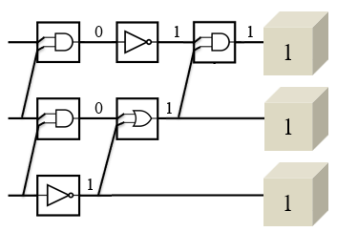



Classical States vs Quantum States
0
0
0
$$\left[\begin{matrix}\begin{matrix}c_{0} \\ c_{1} \\ c_{2}\end{matrix} \\ \begin{matrix}c_{3} \\ c_{4} \\ c_{5}\end{matrix} \\ \begin{matrix}c_{6} \\ c_{7}\end{matrix}\end{matrix}\right]$$
0
0
1
0
1
0
0
1
1
1
0
0
1
0
1
1
1
0
1
1
1
which is a binary string of length $3$
which we call a “state vector” of dimension $2^{3}$
(serving the role of an element in a vector/Hilbert space)
Notes:
And this is the comparison between classical states and quantum states. Here, one thing to be emphasized is that in the quantum case, we can see the quantum state as a state vector, which serves the role of an element in a vector space.
比較的圖，強調 state vector 的好處是為了配合 linear transformation. 線性代數視角。

Slide 7
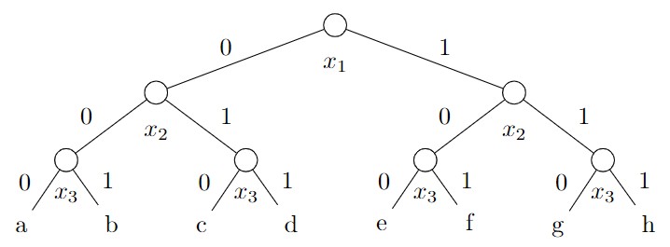

From Decision Trees’ Perspectives
Motivation: To utilize the succinct tree-like model in POPL 2025.
A 3-bit quantum state.
$$\left[\begin{matrix}\begin{matrix}c_{0} \\ c_{1} \\ c_{2}\end{matrix} \\ \begin{matrix}c_{3} \\ c_{4} \\ c_{5}\end{matrix} \\ \begin{matrix}c_{6} \\ c_{7}\end{matrix}\end{matrix}\right]$$
$$\text{Dirac} \text{notation}\text{: }c_{0}\left|000\right\rangle +c_{1}\left|001\right\rangle +c_{2}\left|010\right\rangle +c_{3}\left|011\right\rangle +c_{4}\left|100\right\rangle +c_{5}\left|101\right\rangle +c_{6}\left|110\right\rangle +c_{7}\left|111\right\rangle$$
Notes:
To utilize the succinct tree-like model presented in POPL this year, we can also think of a state vector as a perfect binary tree. In this figure, each amplitude is stored in a leaf and can be traversed from the root. For example, the amplitude of |100> is $c_{4}$ and it can be traversed from this path 1、0、0.

Slide 8
From Decision Trees’ Perspectives
A 3-bit quantum state.
Message 1: A quantum state is a decision tree.
$$\left[\begin{matrix}\begin{matrix}c_{0} \\ c_{1} \\ c_{2}\end{matrix} \\ \begin{matrix}c_{3} \\ c_{4} \\ c_{5}\end{matrix} \\ \begin{matrix}c_{6} \\ c_{7}\end{matrix}\end{matrix}\right]$$
$$\text{Dirac} \text{notation}\text{: }c_{0}\left|000\right\rangle +c_{1}\left|001\right\rangle +c_{2}\left|010\right\rangle +c_{3}\left|011\right\rangle +c_{4}\left|100\right\rangle +c_{5}\left|101\right\rangle +c_{6}\left|110\right\rangle +c_{7}\left|111\right\rangle$$
Notes:
So we can conclude that a quantum state is a decision tree.

Slide 9
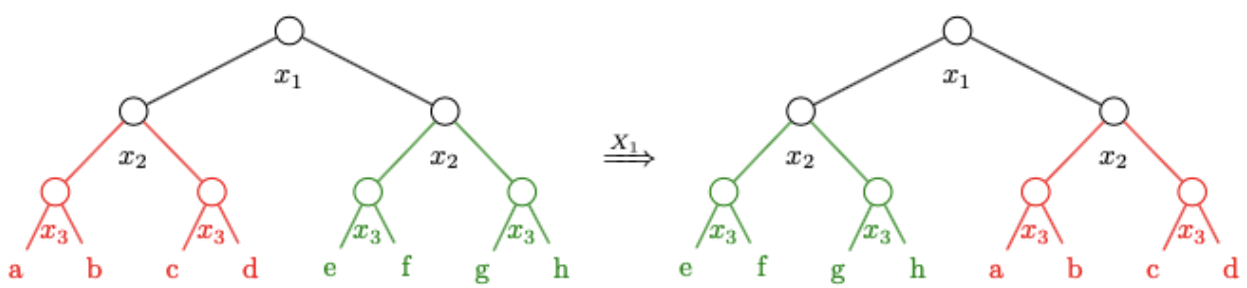
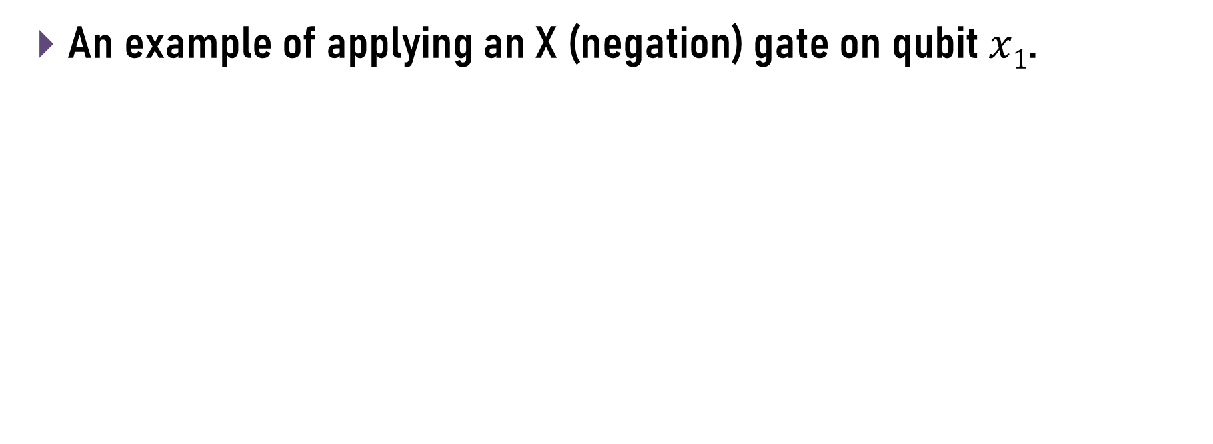
Quantum Gates = Tree Transformations
An example of applying an X (negation) gate on qubit $x1$.
Notes:
And this is a simple example of applying an X gate on the first qubit.
The gate essentially just swaps the two subtrees under the node on the first qubit. That is: The red tree is moved from the left to the right, and the green tree is moved from the right to the left.
就如同傳統電路的位元操作需要邏輯閘，量子電路要對 quantum state 操作也需要 quantum gate。然後這邊是一個最簡單的 X gate 的例子。

Slide 10
Quantum Gates = Tree Transformations
An example of applying an X (negation) gate on qubit $x1$.
Message 2: A quantum gate is just a tree transformation.
Notes:
So we can also conclude that a quantum gate is just a tree transformation.

Slide 11
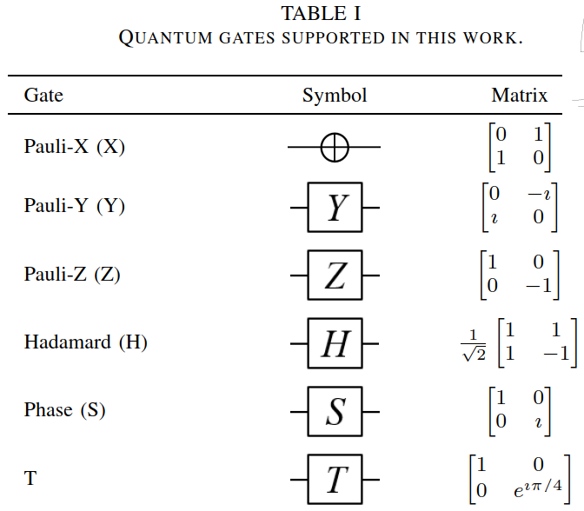
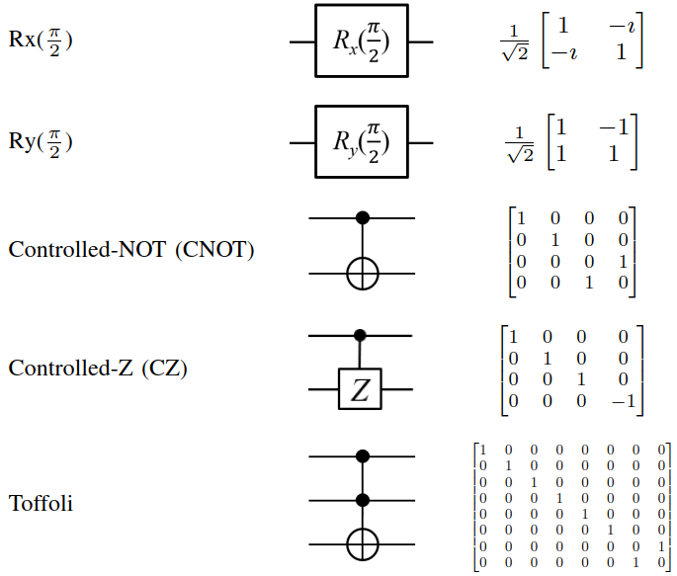
Supported Quantum Gates
https://github.com/fmlab-iis/AutoQ/
Notes:
This table just lists all the gates we support in the tool, and it is only for your reference.

Slide 12
AutoQ 1.0
Automata-based Quantum (Circuit) Verification
Notes:
And in the second part, I will give a quick overview about how to do quantum circuit verification with our tool.
The name AutoQ comes from “Automata-based Quantum Verification.”

Slide 13












AutoQ 1.0
Automata-based Quantum Verification
A Hoare triple would be like …
Precondition
Circuit
Postcondition
$$\{$$
$$\}$$
$$\{$$
$$\}$$
?
$$1$$
$$0$$
$$0$$
$$1$$
$$1$$
$$0$$
$$0$$
$$−1$$
users
Notes:
Our verification is based on a Hoare triple!
A Hoare triple consists of three components as usual, the precondition, the quantum circuit, and the postcondition. All these components should be given by users.

Slide 14
AutoQ 1.0
Automata-based Quantum Verification
A Hoare triple would be like …
The definition of validness?
Precondition
Circuit
Postcondition
$$\{$$
$$\}$$
$$\{$$
$$\}$$
?
$$1$$
$$0$$
$$0$$
$$1$$
$$1$$
$$0$$
$$0$$
$$−1$$
Set of quantum states
Notes:
In AutoQ, we use a set of quantum states in the precondition and the postcondition.
Given this setting, we want to verify, for each tree in the precondition, it will end up in another tree specified in the postcondition after executing the quantum circuit.

Slide 15










AutoQ 1.0
Automata-based Quantum Verification
A Hoare triple would be like …
Precondition
Circuit
Postcondition
$$\{$$
$$\}$$
$$\{$$
$$\}$$
?
$$1$$
$$0$$
$$0$$
$$1$$
$$1$$
$$0$$
$$0$$
$$−1$$
two-qubit gate
First Qubit
H
three-qubit gate
Second Qubit
Z
single-qubit gate
Third Qubit
Notes:
And a quantum circuit is composed of a sequence of quantum gates. They could be single-qubit gates, two-qubit gates, or three-qubit gates. The supported quantum gates are already presented in this table.

Slide 16
























AutoQ 1.0
Automata-based Quantum Verification
A Hoare triple would be like …
Precondition
Circuit
Postcondition
$$\{$$
$$\}$$
$$\{$$
$$\}$$
Z
$$1$$
$$0$$
$$0$$
$$1$$
$$1$$
$$0$$
$$0$$
$$−1$$
$$\{$$
$$\}$$
$$\{$$
$$\}$$
$$\{$$
$$\}$$
$$\{$$
$$\}$$
$$\frac{1}{\sqrt{2}}$$
$$\frac{1}{\sqrt{2}}$$
$$\frac{1}{\sqrt{2}}$$
$$\frac{−1}{\sqrt{2}}$$
$$\frac{1}{\sqrt{2}}$$
$$\frac{1}{\sqrt{2}}$$
$$\frac{−1}{\sqrt{2}}$$
$$\frac{1}{\sqrt{2}}$$
$$1$$
$$0$$
$$0$$
$$1$$
$$1$$
$$0$$
$$0$$
$$−1$$
H
X
H
Notes:
In this framework, we use the precondition as the starting point, and then the quantum gates will transform each tree in the current set to a new tree in the next set. For instance, the X gate in the middle transforms the red tree on the left to the red tree on the right. It also transforms the brown tree on the left to the brown tree on the right. After executing all quantum gates in the circuit, we will obtain the final set.

Slide 17








AutoQ 1.0
Automata-based Quantum Verification
A Hoare triple is valid if …
Precondition
Circuit
Postcondition
$$\{$$
$$\}$$
$$\{$$
$$\}$$
Z
$$1$$
$$0$$
$$0$$
$$1$$
$$1$$
$$0$$
$$0$$
$$−1$$
$$⊆$$
$$\{$$
$$\}$$
$$\{$$
$$\}$$
$$\{$$
$$\}$$
$$\{$$
$$\}$$
$$\frac{1}{\sqrt{2}}$$
$$\frac{1}{\sqrt{2}}$$
$$\frac{1}{\sqrt{2}}$$
$$\frac{−1}{\sqrt{2}}$$
$$\frac{1}{\sqrt{2}}$$
$$\frac{1}{\sqrt{2}}$$
$$\frac{−1}{\sqrt{2}}$$
$$\frac{1}{\sqrt{2}}$$
$$1$$
$$0$$
$$0$$
$$1$$
$$1$$
$$0$$
$$0$$
$$−1$$
H
X
H
Notes:
Finally, we check whether this Hoare triple is valid, which means we check whether the final set is included in the postcondition.
In this case, it is valid because the red tree and the brown tree are both included in the postcondition.

Slide 18
Implementation
Notes:
After introducing the framework, I will explain how to implement it.

Slide 19




1. A set of quantum states … but how?
$$\{$$
$$\}$$
$$\{$$
$$\}$$
Precondition
Circuit
Postcondition
Notes:
First, let’s see how to encode a set of quantum states into a succinct tree-like model.

Slide 20
























$$\{$$
$$\}$$
$$\{$$
$$\}$$
A set of quantum states … but how?
Precondition
Circuit
Postcondition
$$\{$$
$$\}$$
some strings
(Word)
A
U
T
O
Q
Automata
T
A
C
A
S
2
5
$$\{$$
$$\}$$
$$\frac{1}{\sqrt{2}}$$
$$0$$
$$0$$
$$\frac{1}{\sqrt{2}}$$
$$\frac{1}{\sqrt{2}}$$
$$0$$
$$0$$
$$\frac{−1}{\sqrt{2}}$$
$$0$$
$$\frac{1}{\sqrt{2}}$$
$$\frac{1}{\sqrt{2}}$$
$$0$$
$$0$$
$$\frac{1}{\sqrt{2}}$$
$$\frac{−1}{\sqrt{2}}$$
$$0$$
Notes:
Recall this traditional example for a set of strings. If you have taken the formal language course, it is well-known that we can design a finite automata to recognize autoq and tacas25.

Slide 21


$$\{$$
$$\}$$
$$\{$$
$$\}$$
A set of quantum states … but how?
Precondition
Circuit
Postcondition
$$\{$$
$$\}$$
some strings
(Word)
A
U
T
O
Q
Automata
T
A
C
A
S
2
5
$$\{$$
$$\}$$
Level-Synchronized
Tree Automata
(Automata)
$$\frac{1}{\sqrt{2}}$$
$$0$$
$$0$$
$$\frac{1}{\sqrt{2}}$$
$$\frac{1}{\sqrt{2}}$$
$$0$$
$$0$$
$$\frac{−1}{\sqrt{2}}$$
$$0$$
$$\frac{1}{\sqrt{2}}$$
$$\frac{1}{\sqrt{2}}$$
$$0$$
$$0$$
$$\frac{1}{\sqrt{2}}$$
$$\frac{−1}{\sqrt{2}}$$
$$0$$
Notes:
But analogously, for the case of perfect binary trees, we can also develop another tree-like model to recognize them. The model is called level-synchronized tree automata. Or we can simply call it automata for short.

Slide 22




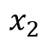








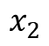
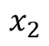








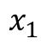
























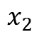








$$\{$$
$$\}$$
$$\{$$
$$\}$$
A set of quantum states … but how?
Precondition
Circuit
Postcondition
$$\{$$
$$\}$$
$$p$$
$$q_{+}$$
$$x_{1}$$
$$q_{±}$$
How does such an automaton accept a tree?
$$①$$
$$\frac{1}{\sqrt{2}}$$
$$0$$
$$0$$
$$\frac{1}{\sqrt{2}}$$
$$\frac{1}{\sqrt{2}}$$
$$0$$
$$0$$
$$\frac{−1}{\sqrt{2}}$$
$$q_{+}$$
$$q_{±}$$
$$q_{+}$$
$$q_{±}$$
$$r_{+}$$
$$x_{2}$$
$${ r}_{0}$$
$$r_{0}$$
$$x_{2}$$
$${ r}_{±}$$
$$r_{0}$$
$$x_{2}$$
$$r_{+}$$
$${ r}_{±}$$
$$x_{2}$$
$$r_{0}$$
$$①$$
$$①$$
$$②$$
$$②$$
$$0$$
$$\frac{1}{\sqrt{2}}$$
$$\frac{1}{\sqrt{2}}$$
$$0$$
$$0$$
$$\frac{1}{\sqrt{2}}$$
$$\frac{−1}{\sqrt{2}}$$
$$0$$
$$r_{0}$$
$$r_{+}$$
$$r_{±}$$
$$r_{±}$$
$$0$$
$$\frac{1}{\sqrt{2}}$$
$$\frac{1}{\sqrt{2}}$$
$$\frac{−1}{\sqrt{2}}$$
Level-Synchronized
Tree Automata
$$①$$
$$②$$
$$①$$
$$①$$
$$②$$
$$②$$
Notes:
This is one quick example of such models. The automaton essentially consists of transitions for each qubit and amplitudes, and we say an automaton accepts a tree if someone can pick a subset of transitions and assemble them into the tree following some rules. In this figure, the transitions on the left together recognizes the set of trees on the right.
%%%
Each node must be assigned a unique symbol by two transitions.
All assembled transitions on the same level should agree on some common label.

Slide 23



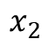



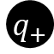




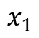

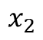

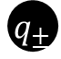







$$\{$$
$$\}$$
$$\{$$
$$\}$$
A set of quantum states … but how?
Precondition
Circuit
Postcondition
$$\{$$
$$\}$$
$$p$$
$$q_{+}$$
$$x_{1}$$
$$q_{±}$$
$$①$$
$$\frac{1}{\sqrt{2}}$$
$$0$$
$$0$$
$$\frac{1}{\sqrt{2}}$$
$$\frac{1}{\sqrt{2}}$$
$$0$$
$$0$$
$$\frac{−1}{\sqrt{2}}$$
$$q_{+}$$
$$q_{±}$$
$$q_{+}$$
$$q_{±}$$
$$r_{+}$$
$$x_{2}$$
$${ r}_{0}$$
$$r_{0}$$
$$x_{2}$$
$${ r}_{±}$$
$$r_{0}$$
$$x_{2}$$
$$r_{+}$$
$${ r}_{±}$$
$$x_{2}$$
$$r_{0}$$
$$①$$
$$①$$
$$②$$
$$②$$
$$0$$
$$\frac{1}{\sqrt{2}}$$
$$\frac{1}{\sqrt{2}}$$
$$0$$
$$0$$
$$\frac{1}{\sqrt{2}}$$
$$\frac{−1}{\sqrt{2}}$$
$$0$$
$$r_{0}$$
$$r_{+}$$
$$r_{±}$$
$$r_{±}$$
$$p$$
$$x_{1}$$
$$0$$
$$\frac{1}{\sqrt{2}}$$
$$\frac{1}{\sqrt{2}}$$
$$\frac{−1}{\sqrt{2}}$$
$$①$$
$$q_{+}$$
$$q_{±}$$
$$①$$
$$x_{2}$$
$$x_{2}$$
$$②$$
$$①$$
$$①$$
$$②$$
$$①$$
$$①$$
$$②$$
$$r_{+}$$
$$r_{0}$$
$$r_{0}$$
$$r_{±}$$
$$\frac{1}{\sqrt{2}}$$
$$0$$
$$0$$
$$\frac{1}{\sqrt{2}}$$
$$①$$
$$①$$
$$①$$
$$①$$
$$②$$
$$②$$
$$②$$
Notes:
Let’s take the upper left tree for example. To accept the tree, we can actually pick the transitions in the green rectangles. I am now going to explain how to assemble the tree with the transitions shaded with green.
On the first qubit, there is only one available transition, so we can only pick it up, and $p$ goes down to the two symbols $q_{+}$ and $q_{±}$.
And on the second qubit, we can only pick the left pair or the right pair, because the selected transitions on the same level must agree on some common label in circles). If we pick the left pair, the agreed common label is 1. If we pick the right pair, the agreed common label is 2. For this particular tree, we should pick the left pair, so $q_{+}$ goes down to $r_{+}$ and $r_{0}$, and $q_{±}$ goes down to $r_{0}$ and $r_{±}$.
And finally on the amplitude level, $r_{0}$ and $r_{+}$ have only one choice, but $r_{±}$ have two choices. Here, both choices are allowed, because if we pick the first one (1), the three transitions have the common label 1, and if I pick the second one (2) the three transitions have the common label 2. For this particular tree, we should pick the first one. So these three transitions are picked. We can see that $r_{0}$ corresponds to 0, $r_{+}$ corresponds to 1 over square root of 2, and $r_{±}$ also corresponds to 1 over square root of 2.
We can assemble all selected transitions into the right tree, so this tree is accepted.

Slide 24
$$\{$$
$$\}$$
$$\{$$
$$\}$$
A set of quantum states … but how?
Precondition
Circuit
Postcondition
$$\{$$
$$\}$$
$$p$$
$$q_{+}$$
$$x_{1}$$
$$q_{±}$$
$$①$$
$$\frac{1}{\sqrt{2}}$$
$$0$$
$$0$$
$$\frac{1}{\sqrt{2}}$$
$$\frac{1}{\sqrt{2}}$$
$$0$$
$$0$$
$$\frac{−1}{\sqrt{2}}$$
Important: The same structure in many subtrees will be merged into one or more transitions for succinctness!
$$q_{+}$$
$$q_{±}$$
$$q_{+}$$
$$q_{±}$$
$$r_{+}$$
$$x_{2}$$
$${ r}_{0}$$
$$r_{0}$$
$$x_{2}$$
$${ r}_{±}$$
$$r_{0}$$
$$x_{2}$$
$$r_{+}$$
$${ r}_{±}$$
$$x_{2}$$
$$r_{0}$$
$$①$$
$$①$$
$$②$$
$$②$$
$$0$$
$$\frac{1}{\sqrt{2}}$$
$$\frac{1}{\sqrt{2}}$$
$$0$$
$$0$$
$$\frac{1}{\sqrt{2}}$$
$$\frac{−1}{\sqrt{2}}$$
$$0$$
$$r_{0}$$
$$r_{+}$$
$$r_{±}$$
$$r_{±}$$
$$0$$
$$\frac{1}{\sqrt{2}}$$
$$\frac{1}{\sqrt{2}}$$
$$\frac{−1}{\sqrt{2}}$$
Level-Synchronized
Tree Automata
$$①$$
$$②$$
$$①$$
$$①$$
$$②$$
$$②$$
Notes:
If the previous explanation is too complicated, you can forget everything but only remember that, the automata will merge the same structure in many subtrees into one or more transitions for succinctness. As you can see, all the four trees have amplitude 0, and all the 0 amplitudes are merged into one transition associated with the symbol $r_{0}$.

Slide 25

$$\{$$
$$\}$$
$$\{$$
$$\}$$
A set of quantum states … but how?
Precondition
Circuit
Postcondition
$$\{$$
$$\}$$
$$p$$
$$q_{+}$$
$$x_{1}$$
$$q_{±}$$
$$①$$
$$\frac{1}{\sqrt{2}}$$
$$0$$
$$0$$
$$\frac{1}{\sqrt{2}}$$
$$\frac{1}{\sqrt{2}}$$
$$0$$
$$0$$
$$\frac{−1}{\sqrt{2}}$$
$$q_{+}$$
$$q_{±}$$
$$q_{+}$$
$$q_{±}$$
$$r_{+}$$
$$x_{2}$$
$${ r}_{0}$$
$$r_{0}$$
$$x_{2}$$
$${ r}_{±}$$
$$r_{0}$$
$$x_{2}$$
$$r_{+}$$
$${ r}_{±}$$
$$x_{2}$$
$$r_{0}$$
$$①$$
$$①$$
$$②$$
$$②$$
$$0$$
$$\frac{1}{\sqrt{2}}$$
$$\frac{1}{\sqrt{2}}$$
$$0$$
$$0$$
$$\frac{1}{\sqrt{2}}$$
$$\frac{−1}{\sqrt{2}}$$
$$0$$
$$r_{0}$$
$$r_{+}$$
$$r_{±}$$
$$r_{±}$$
$$0$$
$$\frac{1}{\sqrt{2}}$$
$$\frac{1}{\sqrt{2}}$$
$$\frac{−1}{\sqrt{2}}$$
Level-Synchronized
Tree Automata
$$①$$
$$②$$
$$①$$
$$①$$
$$②$$
$$②$$
https://dl.acm.org/doi/10.1145/3704869
Notes:
This model was already presented at POPL this year. The paper title is “Verifying Quantum Circuits with Level-Synchronized Tree Automata.” You can see this paper for more details about this model.

Slide 26



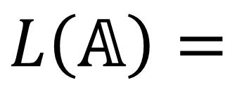
$$\{$$
$$\}$$
$$\{$$
$$\}$$
A set of quantum states … but how?
Precondition
Circuit
Postcondition
$$\{$$
$$\}$$
some strings
(Word)
A
U
T
O
Q
Automata
T
A
C
A
S
2
5
$$\{$$
$$\}$$
Level-Synchronized
Tree Automata
$$L\left(𝔸\right)=$$
$$\frac{1}{\sqrt{2}}$$
$$0$$
$$0$$
$$\frac{1}{\sqrt{2}}$$
$$\frac{1}{\sqrt{2}}$$
$$0$$
$$0$$
$$\frac{−1}{\sqrt{2}}$$
recognizes
$$𝔸$$
$$0$$
$$\frac{1}{\sqrt{2}}$$
$$\frac{1}{\sqrt{2}}$$
$$0$$
$$0$$
$$\frac{1}{\sqrt{2}}$$
$$\frac{−1}{\sqrt{2}}$$
$$0$$
Notes:
Here, we use L(A) to represent the language of trees recognized by the automaton A.

Slide 27




2. Derive the set of quantum states after executing the circuit …
$$\{$$
$$\}$$
$$\{$$
$$\}$$
Precondition
Circuit
Postcondition
Notes:
Second, how to derive the set of quantum states after executing the circuit?

Slide 28








$$\{$$
$$\}$$
$$\{$$
$$\}$$
Algorithm for common quantum gates
Precondition
Circuit
Postcondition
Level-Synchronized
Tree Automaton
Level-Synchronized
Tree Automaton
$$𝔸$$
$$gate(𝔸)$$
$$\{$$
$$\}$$
$$\{$$
$$gate( )$$
$$\}$$
$$gate( )$$
Notes:
Recall that the quantum gates in this framework will transform each tree in the current set to a new tree in the next set.

Slide 29








$$\{$$
$$\}$$
$$\{$$
$$\}$$
Algorithm for common quantum gates
Precondition
Circuit
Postcondition
Level-Synchronized
Tree Automaton
Level-Synchronized
Tree Automaton
$$𝔸$$
$$gate(𝔸)$$
$$\{$$
$$\}$$
$$\{$$
$$gate( )$$
$$\}$$
$$gate( )$$
Notes:
but now, we use an automaton to recognize the set, so for each gate, we developed a corresponding algorithm to derive the resulting automaton. There are 11 supported gates in the table, so we have 11 corresponding algorithms for automata.

Slide 30







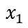












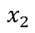
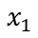



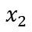






$$\{$$
$$\}$$
$$\{$$
$$\}$$
Algorithm for common quantum gates
Precondition
Circuit
Postcondition
Level-Synchronized
Tree Automaton
Level-Synchronized
Tree Automaton
$$𝔸$$
$$X_{2}(𝔸)$$
$$p$$
$$p$$
$$q_{+}$$
$$x_{1}$$
$$q_{±}$$
$$q_{+}$$
$$x_{1}$$
$$q_{±}$$
$$①$$
$$①$$
$$q_{+}$$
$$q_{±}$$
$$q_{+}$$
$$q_{±}$$
$$q_{+}$$
$$q_{±}$$
$$q_{+}$$
$$q_{±}$$
$$r_{+}$$
$$x_{2}$$
$${ r}_{0}$$
$$r_{0}$$
$$x_{2}$$
$${ r}_{±}$$
$$r_{0}$$
$$x_{2}$$
$$r_{+}$$
$${ r}_{±}$$
$$x_{2}$$
$$r_{0}$$
$$r_{0}$$
$$x_{2}$$
$${ r}_{+}$$
$$r_{±}$$
$$x_{2}$$
$${ r}_{0}$$
$$r_{+}$$
$$x_{2}$$
$$r_{0}$$
$${ r}_{0}$$
$$x_{2}$$
$$r_{±}$$
$$①$$
$$①$$
$$②$$
$$②$$
$$①$$
$$①$$
$$②$$
$$②$$
$$r_{0}$$
$$r_{+}$$
$$r_{±}$$
$$r_{±}$$
$$r_{0}$$
$$r_{+}$$
$$r_{±}$$
$$r_{±}$$
$$0$$
$$\frac{1}{\sqrt{2}}$$
$$\frac{1}{\sqrt{2}}$$
$$\frac{−1}{\sqrt{2}}$$
$$0$$
$$\frac{1}{\sqrt{2}}$$
$$\frac{1}{\sqrt{2}}$$
$$\frac{−1}{\sqrt{2}}$$
$$①$$
$$①$$
$$②$$
$$①$$
$$①$$
$$②$$
$$②$$
$$①$$
$$①$$
$$②$$
$$②$$
$$②$$
Notes:
For instance, the algorithm for X gate applied on the second qubit is just to swap the left child and the right child of all transitions on the second level.

Slide 31





AutoQ 1.0
Automata-based Quantum Verification
A Hoare triple would be like …
Precondition
Circuit
Postcondition
$$\{$$
$$\}$$
$$\{$$
$$\}$$
Z
$$𝔸_{4}$$
$$1$$
$$0$$
$$0$$
$$1$$
$$1$$
$$0$$
$$0$$
$$−1$$
$$𝔸_{0}$$
$$𝔸_{1}$$
$$𝔸_{2}$$
$$𝔸_{3}$$
$$\{$$
$$\}$$
$$\{$$
$$\}$$
$$\{$$
$$\}$$
$$\{$$
$$\}$$
$$\frac{1}{\sqrt{2}}$$
$$\frac{1}{\sqrt{2}}$$
$$\frac{1}{\sqrt{2}}$$
$$\frac{−1}{\sqrt{2}}$$
$$\frac{1}{\sqrt{2}}$$
$$\frac{1}{\sqrt{2}}$$
$$\frac{−1}{\sqrt{2}}$$
$$\frac{1}{\sqrt{2}}$$
$$1$$
$$0$$
$$0$$
$$1$$
$$1$$
$$0$$
$$0$$
$$−1$$
H
X
H
Notes:
So, at each time slot, the set of quantum states is associated with an automaton. The program starts from $𝔸_{0}$, becomes $𝔸_{1}$ after the H gate, becomes $𝔸_{2}$ after the X gate, and ends up $𝔸_{3}$ after the H gate again.

Slide 32




3. Verify a Hoare triple …
$$\{$$
$$\}$$
$$\{$$
$$\}$$
Precondition
Circuit
Postcondition
Notes:
Finally, to verify a Hoare triple,

Slide 33





$$\{$$
$$\}$$
$$\{$$
$$\}$$
To verify a Hoare triple …
Precondition
Circuit
Postcondition
Postcondition
$$\{$$
$$\}$$
$${L(𝔸}_{post})=L(𝔸_{4})=$$
$$1$$
$$0$$
$$0$$
$$−1$$
language inclusion checking of
level-synchronized tree automata ?
$$⊆$$
$$\{$$
$$\}$$
$${L(Circuit(𝔸}_{pre}))=L(𝔸_{3})=$$
$$1$$
$$0$$
$$0$$
$$−1$$
Notes:
We simply check whether the language recognized by $𝔸_{3}$, which is the ending automaton, is included in another language recognized by $𝔸_{4}$, which is the postcondition automaton. This can be done with the proposed inclusion checking algorithm for automata.

Slide 34








$$+$$
AutoQ is fully automated!
$$+$$
Notes:
To sum up, users should provide the desired precondition and postcondition first, and then AutoQ can execute the circuit starting from the precondition, gate by gate, with the corresponding algorithms specialized for automata, and finally check whether the final set is included in the postcondition with the inclusion checking algorithm, so we can say AutoQ is fully automated!

Slide 35
AutoQ 2.0:
From Quantum Circuits to Quantum Programs
Notes:
Okay, so the third part is our main contribution!

Slide 36
Quantum Circuits
(AutoQ 1.0)
Quantum Programs
(AutoQ 2.0)
quantum gates
quantum gates
branches
loops
H
Notes:
The first version of our tool only supports unitary quantum gates. However, there are some advanced quantum algorithms that cannot be described by quantum circuits alone, so in this work, we extend the tool to additionally support quantum programs.
Quantum programs are simply composed of three components: quantum gates, branches, and loops, and the last two items are essentially control flow constructs.
可以說連qiskit都開始支援if-else 和while了
而且最前沿的quantum programming langauge本質上都支援if-else和while

Slide 37

Why measurement?
if ($Mq=b$) then {$P1$} else {$P2$}
while ($Mq=b$) do {𝑃}
Notes:
Why should we introduce measurement here? Because in quantum programs, the branches and loops are implemented as these two statements. As you can see, both statements use measurement results (which are shown in red) to decide which execution path to take, so it is necessary to understand how it works.

Slide 38





Measurement
Case 1 - Measure all qubits together.
Case 2 - Measure only one qubit.
if ($Mq=b$) then {$P1$} else {$P2$}
while ($Mq=b$) do {𝑃}
$$M_{1}$$
$$M_{2}$$
$$M_{3}$$
$$M_{2}$$
Notes:
There are at least two modes of measurement. You can measure all qubits at a time, or measure only one qubit at a time. Both control statements only measure the qubit $q$ at a time, so I will explain the first case first, and then explain how to derive the second case from the first one.

Slide 39













Measurement – All Qubits Together
($c_{i}$: amplitude) ($p_{i}$: probability)
0
0
0
$${\left|c_{0}\right|}^{2}=5\%$$
All possible outcomes$=\left\{\left|000\right\rangle , \left|001\right\rangle , …, \left|110\right\rangle , |111⟩\right\}$
P(outcome$=|i⟩$)$={\left|c_{i}\right|}^{2}$
The resulting state$=|i⟩$.
0
0
1
$${\left|c_{1}\right|}^{2}=7\%$$
$$M_{1}$$
0
1
0
$${\left|c_{2}\right|}^{2}=1\%$$
0
1
1
$${\left|c_{3}\right|}^{2}=4\%$$
$$M_{2}$$
1
0
0
$${\left|c_{4}\right|}^{2}=6\%$$
1
0
1
$${\left|c_{5}\right|}^{2}=2\%$$
$$M_{3}$$
1
1
0
$${\left|c_{6}\right|}^{2}=5\%$$
1
1
1
$${\left|c_{7}\right|}^{2}=70\%$$
Notes:
Recall the quantum state example introduced at the beginning of this talk. If we measure all the three qubits together, the outcome can be any binary string, from 000 to 111, and the probability of the outcome is the absolute square of the leading amplitude.
For example, the probability of the outcome being 110 is the absolute square of $c_{6}$, which is 5%, and
if the outcome actually becomes $|110⟩$, the resulting state should also be$|110⟩$.

Slide 40
















Measurement – All Qubits Together
($c_{i}$: amplitude) ($p_{i}$: probability)
0
0
0
$${\left|c_{0}\right|}^{2}=5\%$$
All possible outcomes$=\left\{\left|000\right\rangle , \left|001\right\rangle , …, \left|110\right\rangle , |111⟩\right\}$
P(outcome$=|i⟩$)$={\left|c_{i}\right|}^{2}$
The resulting state$=|i⟩$.
Normalize the amplitudes such that the summation of all possible outcomes’ probabilities is still 1.
0
0
1
$${\left|c_{1}\right|}^{2}=7\%$$
$$M_{1}$$
0
1
0
$${\left|c_{2}\right|}^{2}=1\%$$
0
1
1
$${\left|c_{3}\right|}^{2}=4\%$$
$$M_{2}$$
1
0
0
$${\left|c_{4}\right|}^{2}=6\%$$
1
0
1
$${\left|c_{5}\right|}^{2}=2\%$$
$$M_{3}$$
1
1
0
$${\left|c_{6}\right|}^{2}=5\%$$
$$c_{0}$$
$$c_{1}$$
$$c_{2}$$
$$c_{3}$$
$$c_{4}$$
$$c_{5}$$
$$c_{6}$$
$$c_{7}$$
$$0$$
$$0$$
$$0$$
$$0$$
$$0$$
$$0$$
$$\frac{c_{6}}{|c_{6}|}$$
$$0$$
1
1
1
$${\left|c_{7}\right|}^{2}=70\%$$
(with amplitude normalization)
Notes:
From the tree transformation, we can find that the amplitudes of non-measured binary strings are all truncated to 0, but the amplitude of the measured outcome is normalized to have unit absolute value.
The reason why there is amplitude normalization is that the summation of probabilities of all possible outcomes should always be 1.

Slide 41
































Contribution 1 - No Amplitude Normalization
No amplitude normalization in the implementation because:
Level-synchronized tree automata merge the same amplitude in different trees into one or more amplitude transitions. After a quantum measurement, one amplitude in different trees may have different scaling factors. We don’t even know what trees a particular transition belongs to, so it is infeasible to identify all scaling factors of an amplitude transition.
$$\{$$
$$\}$$
$$r_{0}$$
$$r_{+}$$
$$r_{±}$$
$$r_{±}$$
$$\frac{1}{\sqrt{2}}$$
$$0$$
$$0$$
$$\frac{1}{\sqrt{2}}$$
$$\frac{1}{\sqrt{2}}$$
$$0$$
$$0$$
$$\frac{−1}{\sqrt{2}}$$
$$0$$
$$\frac{1}{\sqrt{2}}$$
$$\frac{1}{\sqrt{2}}$$
$$\frac{−1}{\sqrt{2}}$$
$$①$$
$$②$$
$$①$$
$$①$$
$$②$$
$$0$$
$$\frac{1}{\sqrt{2}}$$
$$\frac{1}{\sqrt{2}}$$
$$0$$
$$0$$
$$\frac{1}{\sqrt{2}}$$
$$\frac{−1}{\sqrt{2}}$$
$$0$$
$$②$$
Notes:
However, in our implementation, it is impossible to do amplitude normalization, because:
… In this example, this transition with the amplitude negative 1 over the square root of 2 belongs to two trees, the upper right and the lower right.

Slide 42


Contribution 1 - No Amplitude Normalization
No amplitude normalization in the implementation because:
Level-synchronized tree automata merge the same amplitude in different trees into one or more amplitude transitions. After a quantum measurement, one amplitude in different trees may have different scaling factors. We don’t even know what trees a particular transition belongs to, so it is infeasible to identify all scaling factors of an amplitude transition.
$$\{$$
$$\}$$
$$r_{0}$$
$$r_{+}$$
$$r_{±}$$
$$r_{±}$$
$$\frac{1}{\sqrt{2}}$$
$$0$$
$$0$$
$$\frac{1}{\sqrt{2}}$$
$$\frac{1}{\sqrt{2}}$$
$$0$$
$$0$$
$$\frac{−1}{\sqrt{2}}$$
$$−1$$
$$0$$
$$\frac{1}{\sqrt{2}}$$
$$\frac{1}{\sqrt{2}}$$
$$\frac{−1}{\sqrt{2}}$$
$$①$$
$$②$$
$$①$$
$$①$$
$$②$$
$$0$$
$$\frac{1}{\sqrt{2}}$$
$$\frac{1}{\sqrt{2}}$$
$$0$$
$$0$$
$$\frac{1}{\sqrt{2}}$$
$$\frac{−1}{\sqrt{2}}$$
$$0$$
$$②$$
$$0$$
Notes:
If the measurement outcome is 11 (or the rightmost leaf), then in this (右上) tree only the rightmost branch has non-zero amplitude, so this leaf should be scaled to negative 1, but in this (右下) tree the third branch has no amplitude, so the leaf should be scaled to 0. The two different scaling factors in two trees cannot be discovered without exploring all possible trees.

Slide 43


























Contribution 1 - No Amplitude Normalization
No amplitude normalization in the implementation because:
Even if this mechanism is feasible to implement, the resulting automaton may lack the succinctness because one amplitude transition may be transformed into many pieces with different scaling factors. Different amplitudes cannot be merged, so the size of automata may explode, drastically degrading the performance.
$$\{$$
$$\}$$
?
?
$$r_{±}$$
$$\frac{1}{\sqrt{2}}$$
$$0$$
$$0$$
$$\frac{1}{\sqrt{2}}$$
$$\frac{1}{\sqrt{2}}$$
$$0$$
$$0$$
$$\frac{−1}{\sqrt{2}}$$
$$−1$$
$$−1$$
$$0$$
$$\frac{−1}{\sqrt{2}}$$
$$②$$
$$0$$
$$\frac{1}{\sqrt{2}}$$
$$\frac{1}{\sqrt{2}}$$
$$0$$
$$0$$
$$\frac{1}{\sqrt{2}}$$
$$\frac{−1}{\sqrt{2}}$$
$$0$$
$$0$$
Notes:
The second reason is that … Continuing with the same example, this transition will be copied into two different transitions with amplitudes -1 and 0.

Slide 44








Contribution 1 - No Amplitude Normalization
No amplitude normalization in the implementation still works because each non-scaled tree intrinsically represents a normalized valid tree (the sum of probabilities is 1) with the unique positive real factor.
intrinsically represents
$$c_{0}$$
$$c_{1}$$
$$c_{2}$$
$$c_{3}$$
$$\frac{c_{0}}{\sqrt{{\left|c_{0}\right|}^{2}+{\left|c_{1}\right|}^{2}+{\left|c_{2}\right|}^{2}+{\left|c_{3}\right|}^{2}}}$$
$$\frac{c_{1}}{\sqrt{{\left|c_{0}\right|}^{2}+{\left|c_{1}\right|}^{2}+{\left|c_{2}\right|}^{2}+{\left|c_{3}\right|}^{2}}}$$
$$\frac{c_{2}}{\sqrt{{\left|c_{0}\right|}^{2}+{\left|c_{1}\right|}^{2}+{\left|c_{2}\right|}^{2}+{\left|c_{3}\right|}^{2}}}$$
$$\frac{c_{3}}{\sqrt{{\left|c_{0}\right|}^{2}+{\left|c_{1}\right|}^{2}+{\left|c_{2}\right|}^{2}+{\left|c_{3}\right|}^{2}}}$$
Notes:
In fact, even if we ignore amplitude normalization, this method still works, because each non-scaled tree intrinsically represents a valid tree with the unique positive real factor. In this example, the upper tree intrinsically represents the lower tree by dividing “this” common factor to keep the sum of probabilities being 1.

Slide 45

Measurement – All Qubits Together
($c_{i}$: amplitude) ($p_{i}$: probability)
0
0
0
$${\left|c_{0}\right|}^{2}=5\%$$
All possible outcomes$=\left\{\left|000\right\rangle , \left|001\right\rangle , …, \left|110\right\rangle , |111⟩\right\}$
P(outcome$=|i⟩$)$={\left|c_{i}\right|}^{2}$
The resulting state$=|i⟩$.
0
0
1
$${\left|c_{1}\right|}^{2}=7\%$$
$$M_{1}$$
0
1
0
$${\left|c_{2}\right|}^{2}=1\%$$
0
1
1
$${\left|c_{3}\right|}^{2}=4\%$$
$$M_{2}$$
1
0
0
$${\left|c_{4}\right|}^{2}=6\%$$
1
0
1
$${\left|c_{5}\right|}^{2}=2\%$$
$$M_{3}$$
1
1
0
$${\left|c_{6}\right|}^{2}=5\%$$
$$c_{0}$$
$$c_{1}$$
$$c_{2}$$
$$c_{3}$$
$$c_{4}$$
$$c_{5}$$
$$c_{6}$$
$$c_{7}$$
$$0$$
$$0$$
$$0$$
$$0$$
$$0$$
$$0$$
$$c_{6}$$
$$0$$
1
1
1
$${\left|c_{7}\right|}^{2}=70\%$$
(no amplitude normalization)
Notes:
So the $|110⟩$ branch keeps the original amplitude $c_{6}$ after the measurement in our implementation.

Slide 46










Measurement – Only One Qubit
($c_{i}$: amplitude) ($p_{i}$: probability)
0
0
0
$${\left|c_{0}\right|}^{2}=5\%$$
All possible outcomes$=\left\{{\left|0\right\rangle }_{2}, {\left|1\right\rangle }_{2}\right\}$
P(outcome$={\left|i\right\rangle }_{2}$)$=\sum_{\begin{aligned}x∈\{0,1\}, \\ y∈\{0,1\}\end{aligned}}{\text{P}\text{(}\text{outcome}=|xiy⟩)}$
The resulting state $=\frac{\sum_{\begin{aligned}x∈\{0,1\}, \\ y∈\{0,1\}\end{aligned}}{c_{xiy}|xiy⟩}}{\sqrt{\text{P}\text{(}\text{outcome} ={\left|i\right\rangle }_{2}\text{)}}}$.
0
0
1
$${\left|c_{1}\right|}^{2}=7\%$$
0
1
0
$${\left|c_{2}\right|}^{2}=1\%$$
0
1
1
$${\left|c_{3}\right|}^{2}=4\%$$
$$M_{2}$$
1
0
0
$${\left|c_{4}\right|}^{2}=6\%$$
1
0
1
$${\left|c_{5}\right|}^{2}=2\%$$
1
1
0
$${\left|c_{6}\right|}^{2}=5\%$$
1
1
1
$${\left|c_{7}\right|}^{2}=70\%$$
(normalization)
Notes:
In the second case, if we measure only one qubit, the outcome can only be |0> or |1> certainly, and the probability of the outcome being the state |i> is the summation of all the quantum states where the measured qubit is fixed to be i.
Let’s take the middle qubit for example. If we want the outcome to be 0, then its probability is the summation of 000, 001, 100, and 101, which is 20%, and the resulting state is also the summation of these four states with their corresponding amplitudes divided by the normalization factor.

Slide 47
















Measurement – Only One Qubit
($c_{i}$: amplitude) ($p_{i}$: probability)
0
0
0
$${\left|c_{0}\right|}^{2}=5\%$$
All possible outcomes$=\left\{{\left|0\right\rangle }_{2}, {\left|1\right\rangle }_{2}\right\}$
P(outcome$={\left|i\right\rangle }_{2}$)$=\sum_{\begin{aligned}x∈\{0,1\}, \\ y∈\{0,1\}\end{aligned}}{\text{P}\text{(}\text{outcome}=|xiy⟩)}$
The resulting state $=\frac{\sum_{\begin{aligned}x∈\{0,1\}, \\ y∈\{0,1\}\end{aligned}}{c_{xiy}|xiy⟩}}{\sqrt{\text{P}\text{(}\text{outcome} ={\left|i\right\rangle }_{2}\text{)}}}$.
0
0
1
$${\left|c_{1}\right|}^{2}=7\%$$
0
1
0
$${\left|c_{2}\right|}^{2}=1\%$$
0
1
1
$${\left|c_{3}\right|}^{2}=4\%$$
$$M_{2}$$
1
0
0
$${\left|c_{4}\right|}^{2}=6\%$$
1
0
1
$${\left|c_{5}\right|}^{2}=2\%$$
1
1
0
$${\left|c_{6}\right|}^{2}=5\%$$
1
1
1
$${\left|c_{7}\right|}^{2}=70\%$$
(normalization)
$$c_{0}$$
$$c_{1}$$
$$c_{2}$$
$$c_{3}$$
$$c_{4}$$
$$c_{5}$$
$$c_{6}$$
$$c_{7}$$
$$c_{0}$$
$$c_{1}$$
$$0$$
$$0$$
$$c_{4}$$
$$c_{5}$$
$$0$$
$$0$$
(no amplitude normalization)
Notes:
Similarly, we also do not normalize the amplitudes in trees and automata, so the red amplitudes should be kept the same.

Slide 48
Execution Path Decided by Measurement
if ($Mq=b$) then {$P1$} else {$P2$}
while ($Mq=b$) do {𝑃}
Notes:
So far, we already have the background knowledge for measurement.
To decide the execution path in the control statement, the quantum program first measures the desired qubit $q$, obtains the outcome with the operator $M_{q}$, and then decide which path to take, by comparing the outcome to $b$.

Slide 49









if ($Mq=b$) then {$P1$} else {$P2$}
$$\{$$
$$\}$$
$$0$$
$$0$$
$$a_{0}$$
$$a_{1}$$
$$L\left(𝔸_{1}\right)$$
Notes:
This is our first control flow construct, if-else statement. This example applies the negative X on the second qubit when the first qubit is measured to be 1. It also demonstrates how to use control flow to construct a non-standard quantum gate.
We already know that AutoQ essentially maintains an automaton at any time in the program, so here, I will discuss how the automaton changes in this control flow.
The first line is the precondition. The two numbers $a_{0}$ and $a_{1}$ are arbitrary complex amplitudes. The tree is shown on the right.
We should note that this is essentially a set but containing only one tree (which is a singleton), and this set is recognized by the automaton $𝔸_{1}$.

Slide 50












if ($Mq=b$) then {$P1$} else {$P2$}
$$\{$$
$$\}$$
$$\{$$
$$\}$$
$$0$$
$$0$$
$$a_{0}$$
$$a_{1}$$
$$\frac{a_{0}}{\sqrt{2}}$$
$$\frac{a_{1}}{\sqrt{2}}$$
$$\frac{−a_{1}}{\sqrt{2}}$$
$$\frac{−a_{0}}{\sqrt{2}}$$
$$L\left(𝔸_{2}\right)$$
Notes:
As explained before, for each gate we already developed an algorithm specialized for automata. So on the second line, we apply the automaton algorithm for the H gate on the first qubit and then another automaton algorithm for the CX gate on both qubits, and the resulting set is recognized by $𝔸_{2}$.

Slide 51














if ($Mq=b$) then {$P1$} else {$P2$}
$$\{$$
$$\}$$
$$\frac{a_{0}}{\sqrt{2}}$$
$$\frac{a_{1}}{\sqrt{2}}$$
$$\frac{−a_{1}}{\sqrt{2}}$$
$$\frac{−a_{0}}{\sqrt{2}}$$
if ($M_{1}=0$) then { $X_{1}$ } else { }
$$\{$$
$$\}$$
$$\frac{a_{0}}{\sqrt{2}}$$
$$\frac{a_{1}}{\sqrt{2}}$$
$$0$$
$$0$$
$$L\left(𝔸_{3−if−before}\right)$$
Notes:
The third line is the branch statement.
And on this line, we can split into two cases (if-path and else-path). Let’s consider the if-path first.
The program enters the if path if the first qubit is measured to be 0, so we keep the left subtree but truncate the right subtree to 0. As emphasized before, we do not normalize the amplitudes in trees.

Slide 52














if ($Mq=b$) then {$P1$} else {$P2$}
if ($M_{1}=0$) then { $X_{1}$ } else { }
$$\{$$
$$\}$$
$$\frac{a_{0}}{\sqrt{2}}$$
$$\frac{a_{1}}{\sqrt{2}}$$
$$0$$
$$0$$
$$\{$$
$$\}$$
$$0$$
$$0$$
$$\frac{a_{0}}{\sqrt{2}}$$
$$\frac{a_{1}}{\sqrt{2}}$$
$$L\left(𝔸_{3−if−after}\right)$$
Notes:
And the X gate just swaps the two subtrees under the first qubit.

Slide 53








if ($Mq=b$) then {$P1$} else {$P2$}
$$\{$$
$$\}$$
$$\frac{a_{0}}{\sqrt{2}}$$
$$\frac{a_{1}}{\sqrt{2}}$$
$$\frac{−a_{1}}{\sqrt{2}}$$
$$\frac{−a_{0}}{\sqrt{2}}$$
if ($M_{1}=0$) then { $X_{1}$ } else { }
$$\{$$
$$\}$$
$$0$$
$$0$$
$$\frac{−a_{1}}{\sqrt{2}}$$
$$\frac{−a_{0}}{\sqrt{2}}$$
$$L\left(𝔸_{3−else}\right)$$
Notes:
The second case is the else-path. The program enters the else path if the first qubit is measured to be 1, so we keep the right subtree but truncate the left subtree to 0.

Slide 54























if ($Mq=b$) then {$P1$} else {$P2$}
$$\{$$
$$0$$
$$0$$
$$\frac{a_{0}}{\sqrt{2}}$$
$$\frac{a_{1}}{\sqrt{2}}$$
$$\}$$
if ($M_{1}=0$) then { $X_{1}$ } else { }
$$0$$
$$0$$
$$\frac{−a_{1}}{\sqrt{2}}$$
$$\frac{−a_{0}}{\sqrt{2}}$$
$$L\left(𝔸_{3}\right)$$
$$\{$$
$$\}$$
$$\{$$
$$\}$$
$$0$$
$$0$$
$$\frac{a_{0}}{\sqrt{2}}$$
$$\frac{a_{1}}{\sqrt{2}}$$
$$0$$
$$0$$
$$\frac{−a_{1}}{\sqrt{2}}$$
$$\frac{−a_{0}}{\sqrt{2}}$$
Notes:
And after the branch statement on Line 3, the two sets after the if-path and the else-path are merged together as another bigger set to be executed on.
If we focus on the red part, we can verify that this example essentially applies the negative X on the second qubit when the first qubit is measured to be 1.

Slide 55




if ($Mq=b$) then {$P1$} else {$P2$}
$$\{$$
$$0$$
$$0$$
$$\frac{a_{0}}{\sqrt{2}}$$
$$\frac{a_{1}}{\sqrt{2}}$$
$$\}$$
if ($M_{1}=0$) then { $X_{1}$ } else { }
$$0$$
$$0$$
$$\frac{−a_{1}}{\sqrt{2}}$$
$$\frac{−a_{0}}{\sqrt{2}}$$
$$L\left(𝔸_{3}\right)$$
$$\{$$
$$\}$$
$$\{$$
$$\}$$
$$0$$
$$0$$
$$\frac{a_{0}}{\sqrt{2}}$$
$$\frac{a_{1}}{\sqrt{2}}$$
$$0$$
$$0$$
$$\frac{−a_{1}}{\sqrt{2}}$$
$$\frac{−a_{0}}{\sqrt{2}}$$
Notes:
You may notice that the final set has a remaining scaling factor, the square root of 2, compared to the specified postcondition. To verify the final set is contained in the postcondition up to a scaling factor, we have another contribution.

Slide 56





















Contribution 2 - Up-to-scaling Inclusion Checking
Definition: $L(𝔸)⊆L(𝔹)$ if for each tree $q_{𝔸}$in $L(𝔸)$, there is another tree $q_{\text{𝔹}}$in $L(𝔹)$ such that $q_{𝔸}=r⋅q_{𝔹}$ for some real number $r>0$. $L(𝔸) L(𝔹)$
See the paper for the implementation detail.
$$⊆$$
$$0$$
$$0$$
$$\frac{a_{0}}{r_{1}}$$
$$\frac{a_{1}}{r_{1}}$$
$$0$$
$$0$$
$$\frac{−a_{1}}{{ r}_{2}}$$
$$\frac{−a_{0}}{r_{2}}$$
$$uts$$
$$0$$
$$0$$
$$a_{0}$$
$$a_{1}$$
$$0$$
$$0$$
$$−a_{1}$$
$$−a_{0}$$
https://arxiv.org/abs/2411.09121
Notes:
The second contribution is that we developed an up-to-scaling inclusion checking algorithm for automata.
The definition is that, we say the language recognized by A is included in another language recognized by B, if … the two trees are proportional. In this example, we say L(A) is included in L(B) because this (left) tree is proportional to that (left) tree with the factor $r_{1}$, and this (right) tree is proportional to that (right) tree with the factor $r_{2}$.
You can see the paper on arXiv for more details about the implementation.

Slide 57









while ($Mq=b$) do {𝑃}
$$\{$$
$$\}$$
$$0$$
$$0$$
$$a_{0}$$
$$a_{1}$$
$$L\left(𝔸_{1}\right)$$
Notes:
And the second control flow construct is while loops.
Recall that this gate demonstrated in the if-else construct only works if the first qubit is measured to be 1. It is totally not complete enough, so here we use the while loop to re-implement this operation again.
The first line is the same as in the if-else example.

Slide 58













while ($Mq=b$) do {𝑃}
$$\{$$
$$\}$$
$$\{$$
$$\}$$
$$0$$
$$0$$
$$a_{0}$$
$$a_{1}$$
$$\frac{a_{0}}{\sqrt{2}}$$
$$\frac{a_{1}}{\sqrt{2}}$$
$$\frac{−a_{1}}{\sqrt{2}}$$
$$\frac{−a_{0}}{\sqrt{2}}$$
$$L\left(𝔸_{2}\right)$$
Notes:
The second line is still the same as in the if-else example.

Slide 59















while ($Mq=b$) do {𝑃}
Step 1. Guess the loop invariant.
Step 2. Verify that the entry set is contained in the loop invariant.
$$\{$$
$$\}$$
$$\frac{a_{0}}{\sqrt{2}}$$
$$\frac{a_{1}}{\sqrt{2}}$$
$$\frac{−a_{1}}{\sqrt{2}}$$
$$\frac{−a_{0}}{\sqrt{2}}$$
$$⊆$$
$$uts$$
$$\{$$
$$\}$$
$$\frac{a_{0}}{\sqrt{2}}$$
$$\frac{a_{1}}{\sqrt{2}}$$
$$\frac{−a_{1}}{\sqrt{2}}$$
$$\frac{−a_{0}}{\sqrt{2}}$$
$$L\left(𝔸_{3}\right)$$
Notes:
The third line is the beginning of the loop. Before entering the loop, users should first specify the loop invariant, and verify that the entry set after Line 2 is contained in the specified loop invariant up to scaling factors.
In this case, two sets are exactly the same, so the inclusion holds.

Slide 60














while ($Mq=b$) do {𝑃}
$$\{$$
$$\}$$
$$\frac{a_{0}}{\sqrt{2}}$$
$$\frac{a_{1}}{\sqrt{2}}$$
$$\frac{−a_{1}}{\sqrt{2}}$$
$$\frac{−a_{0}}{\sqrt{2}}$$
while ($M_{1}=0$) do { $X_{1};H_{1};C_{1}X_{2}$ }
$$\{$$
$$\}$$
$$\frac{a_{0}}{\sqrt{2}}$$
$$\frac{a_{1}}{\sqrt{2}}$$
$$0$$
$$0$$
$$L\left(𝔸_{4−before}\right)$$
Notes:
On Line 4, we can also split into two cases. The first one is the path entering the loop.
The program enters the loop if the first qubit is measured to be 0, so we keep the left subtree but truncate the right subtree to 0.

Slide 61












while ($Mq=b$) do {𝑃}
while ($M_{1}=0$) do { $X_{1};H_{1};C_{1}X_{2}$ }
$$\{$$
$$\}$$
$$\{$$
$$\}$$
$$\frac{a_{0}}{\sqrt{2}}$$
$$\frac{a_{1}}{\sqrt{2}}$$
$$0$$
$$0$$
$$\frac{a_{0}}{2}$$
$$\frac{a_{1}}{2}$$
$$\frac{−a_{1}}{ 2}$$
$$\frac{−a_{0}}{ 2}$$
$$L\left(𝔸_{4−after}\right)$$
Notes:
And in the loop body, the program executes the gate algorithms as usual.

Slide 62








while ($Mq=b$) do {𝑃}
Step 3. Verify that the exit set is also
contained in the loop invariant.
$$\{$$
$$\}$$
$$\frac{a_{0}}{\sqrt{2}}$$
$$\frac{a_{1}}{\sqrt{2}}$$
$$\frac{−a_{1}}{\sqrt{2}}$$
$$\frac{−a_{0}}{\sqrt{2}}$$
$$⊆$$
while ($M_{1}=0$) do { $X_{1};H_{1};C_{1}X_{2}$ }
$$uts$$
$$\{$$
$$\}$$
$$\frac{a_{0}}{2}$$
$$\frac{a_{1}}{ 2}$$
$$\frac{−a_{1}}{ 2}$$
$$\frac{−a_{0}}{ 2}$$
Notes:
To repeat the loop again, the program should verify, the exit set is still contained in the prespecified loop invariant up to scaling factors. In this case, the scaling factor is square root of 2, so the inclusion holds.

Slide 63













while ($Mq=b$) do {𝑃}
The resulting set after Line 4 is exactly the postcondition.
This algorithm essentially applies the negative X gate on the 2nd qubit.
$$\{$$
$$\}$$
$$\frac{a_{0}}{\sqrt{2}}$$
$$\frac{a_{1}}{\sqrt{2}}$$
$$\frac{−a_{1}}{\sqrt{2}}$$
$$\frac{−a_{0}}{\sqrt{2}}$$
$$\{$$
$$\}$$
$$0$$
$$0$$
$$\frac{−a_{1}}{\sqrt{2}}$$
$$\frac{−a_{0}}{\sqrt{2}}$$
$$L\left(𝔸_{4}\right)$$
Notes:
And the other case is the path jumping out of the loop. The condition is the first qubit measured to be 1, so from the loop invariant, we keep the right subtree but truncate the left subtree to 0.
This resulting set is exactly the postcondition up to the scaling factor of square root of 2. Compare the precondition with the postcondition. We observe that this algorithm essentially applies the negative X on the second qubit (in all cases).

Slide 64

Quantum Algorithm Examples
Weakly measured Grover’s search: no need to know the number of iterations
Notes:
This is the experimental result. We have two benchmarks used in the paper.
The first one is the weakly measured Grover’s search. It compresses all iterations of the usual Grover’s search algorithm into one iteration of a while-loop version. The advantage is that we can implement this new version without knowing the number of iterations in advance.

Slide 65
Quantum Algorithm Examples
Repeat-until-success: implement quantum gates with while-loops.
Notes:
The second one is the repeat-until-success programs. It uses while-loops to implement a quantum gate. As the name suggests, the program outputs the desired operation when jumping out of the loop. The negative X gate introduced in previous pages is also a kind of repeat-until-success programs.
%%%
The advantage is that such programs have been shown to be more efficient (in terms of circuit depth) than ancilla-free techniques.

Slide 66
Quantum Algorithm Examples
Notes:
From the experimental result, we can conclude that
Our tool is able to verify weakly measured Grover’s search for large numbers of qubits in reasonable time, and
It can also verify these nontrivial quantum gates instantaneously.

Slide 67
Possible Improvement
Automatic synthesis of loop invariants.
Notes:
Finally, one potential problem of this work is that sometimes it may be very difficult to figure out the loop invariant of a program, so it is imperative to develop an algorithm to automatically synthesize loop invariants in the future.

Slide 68




Takeaways: What You Should Know
We propose a quantum verification framework with Hoare triples.
We use level-synchronized tree automata to encode sets of quantum states and fully automate the framework.
We extend the framework to additionally support branches and loops, which constitute quantum programs.
We bypass the need of normalizing the amplitudes and successfully develop the up-to-scaling inclusion checking algorithm.
Notes:
This is the summary.
We proposed a quantum verification framework with Hoare triples and implemented the framework in AutoQ in the past two years.
We developed level-synchronized tree automata to encode sets of quantum states, which was already presented in POPL this year.
In this work, we extended the framework to additionally support branches and loops, which constitute quantum programs.
And we also bypass the need of normalizing the amplitudes and successfully develop the up-to-scaling inclusion checking algorithm.

Slide 69
THE END
Notes:
So, this is my talk and I am happy to take any question. Thank you!

Slide 70


Quantum Algorithm Examples
Weakly Measured Grover’s Search → no need for the number of iterations
Notes:
The weakly measured version eliminates the need for knowing the number of iterations, making the algorithm more applicable.

Slide 71
Quantum Algorithm Examples
Repeat-Until-Success
Notes:
Repeat-until-success programs are a general framework that was introduced to simplify
quantum circuit decomposition (we introduced an example of generating the “−𝑋”
gate via the RUS framework in Section 3). RUS programs have been shown to be more efficient (in terms of circuit depth) than ancilla-free techniques when it comes to synthesizing single-qubit gates (cf. [41,10]).
Conclusions. — We have developed an efficient algorithm to synthesize an arbitrary single-qubit gate into a RUS circuit. The leading term for the expected T count is given by c log2ð1=εÞ, where c is approximately 1.15 for axial rotations. On average, our algorithm achieves a factor of 2.5 improvement over the theoretical lower bound for ancilla-free unitary Clifford + T decomposition, significantly reducing the resources required to implement quantum algorithms on a device.

